Slide 1
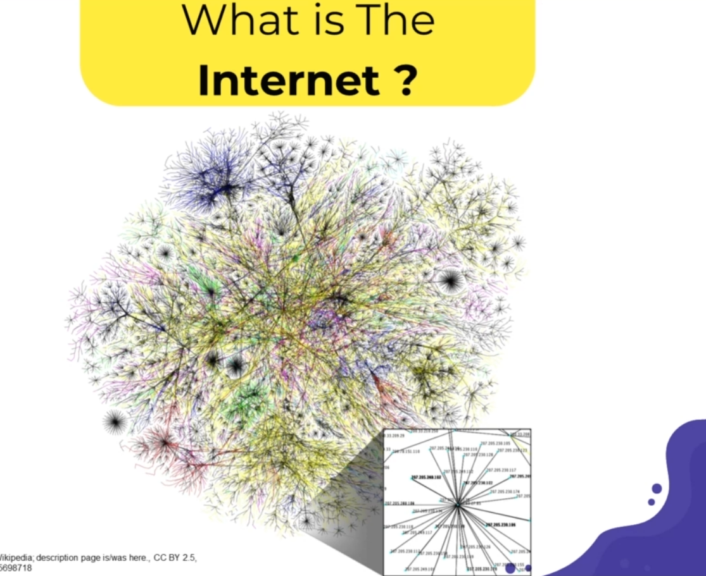
Web Design and Development I
Chapter 1
Basics of the Internet and the web

Slide 2
Outlines of the Chapter:
The Internet
World Wide Web (WWW)
Application Layer Protocols
Web browser
Web Site Development Basics
Web and internet Terminologies

Slide 3

Discussion Points
What is Internet ?
How internet Works ?
What is World Wide Web (WWW)?
What is a website ?
What is URL ?
What is a web Browser ?

Slide 4
1. What is the Internet ?
The Internet is a global Connection of networks that enables computers of all kinds to directly and transparently communicate and share services throughout the world.
It is a network of networks that consists of millions of
private,
public,
academic,
business,
government networks
of local to global scope, linked by a broad array of electronic, wireless, and optical networking technologies.
The Internet carries an extensive range of information resources and services.

Slide 5
(Continued…)
In 1969 the precursor of Internet is born: ARPAnet.
ARPA = Advanced Research Projects Agency sponsored by the American Department of
Defense (DOD).
Designed to connect military research centers.
Distributed computer system able to survive a nuclear attack.
Problem: ARPAnet could connect only networks of the same type.
In 1970, ARPA starts developing the Transmission Control Protocol / Internet Protocol (TCP/IP), a technology for connecting networks of different types (produced by different companies).
Other networks appear, such as CSNET and BITNET.
The Internet = a network of networks.
People around the world share ideas, information, comments, and stories.

Slide 6
(Continued…)
The Internet is a global system of interconnected computer networks and a short form for INTERconnected NETwork.
Each network is independent from its neighbors, and so ultimately, no one country or organization "owns" the Internet.
The Internet's design also mandates that all hosts (computers) connected through the network are equal, or peers. "no single point of failure" goal since there are no easily-targeted "master" servers required to keep traffic moving.

Slide 8
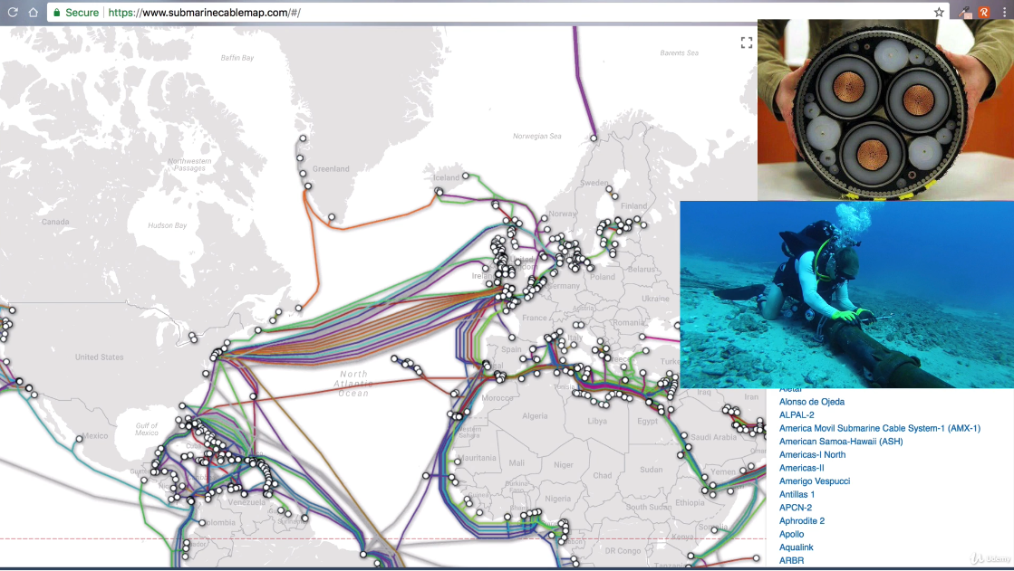
Internets global network with submarine backbone

Slide 9
Popular services over the internet:
Email (electronic mail) is the most popular service.
Web browsing to find information.
Newsgroups :
are collections of messages on various subject
FTP (File Transfer Protocol).
You can copy files from one computer to another over the Internet.
Telnet or remote login.
Permits your computer to log onto another computer and use it as if you were there.
Chatrooms.
You can exchange messages with other
Internet services for companies:
e-commerce, etc.

Slide 10
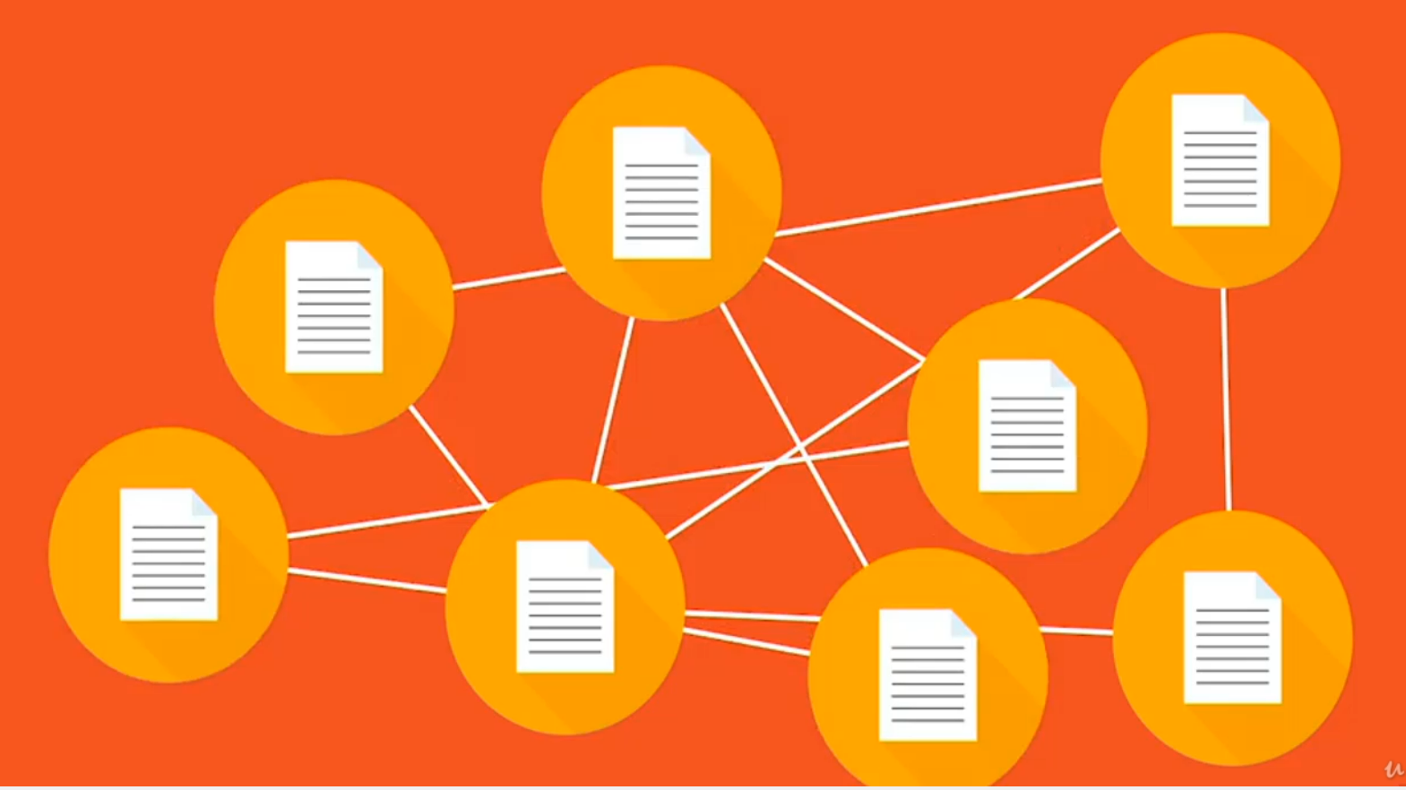
2. What is WWW?
WWW stands for World Wide Web.
A technical definition of the World Wide Web is − All the resources and users on the Internet that are using the Hypertext Transfer Protocol (HTTP).
WWW (World Wide Web): It is a collection of interlinked documents that are accessible over the Internet.
It consists of millions of web pages that contain text, images, voice and videos.

Slide 11
(Continued…)
The World Wide Web allows computer users to locate and view multimedia-based documents (i.e., documents with text, graphics, animations, audios or videos) on almost any subject.
Even though the Internet was developed more than three decades ago, the introduction of the World Wide Web is a relatively recent event.
In 1990, Tim Berners-Lee of CERN (the European Laboratory for Particle Physics) developed the World Wide Web and several communication protocols that form the backbone of the Web.

Slide 12
(Continued…)
The backbone of the World Wide Web is the Hypertext Markup Language, often simply referred to as HTML.
The Web is known as a client-server system. Your computer is the client and the remote computers that store electronic files are the servers.
The Web is a distributed network.
That means there is no central computer for the World Wide Web. Any server on the Web can be accessed directly by any client. If a server on the World Wide Web malfunctions, it doesn't affect the performance of other servers.

Slide 13
(Continued…)
Most of the documents on the World Wide Web are written in Hypertext Markup Language (HTML).
HTML provides instructions for the client software on how the document should be displayed.
HTML also contains information about how to link up to other documents on the Web.

Slide 14
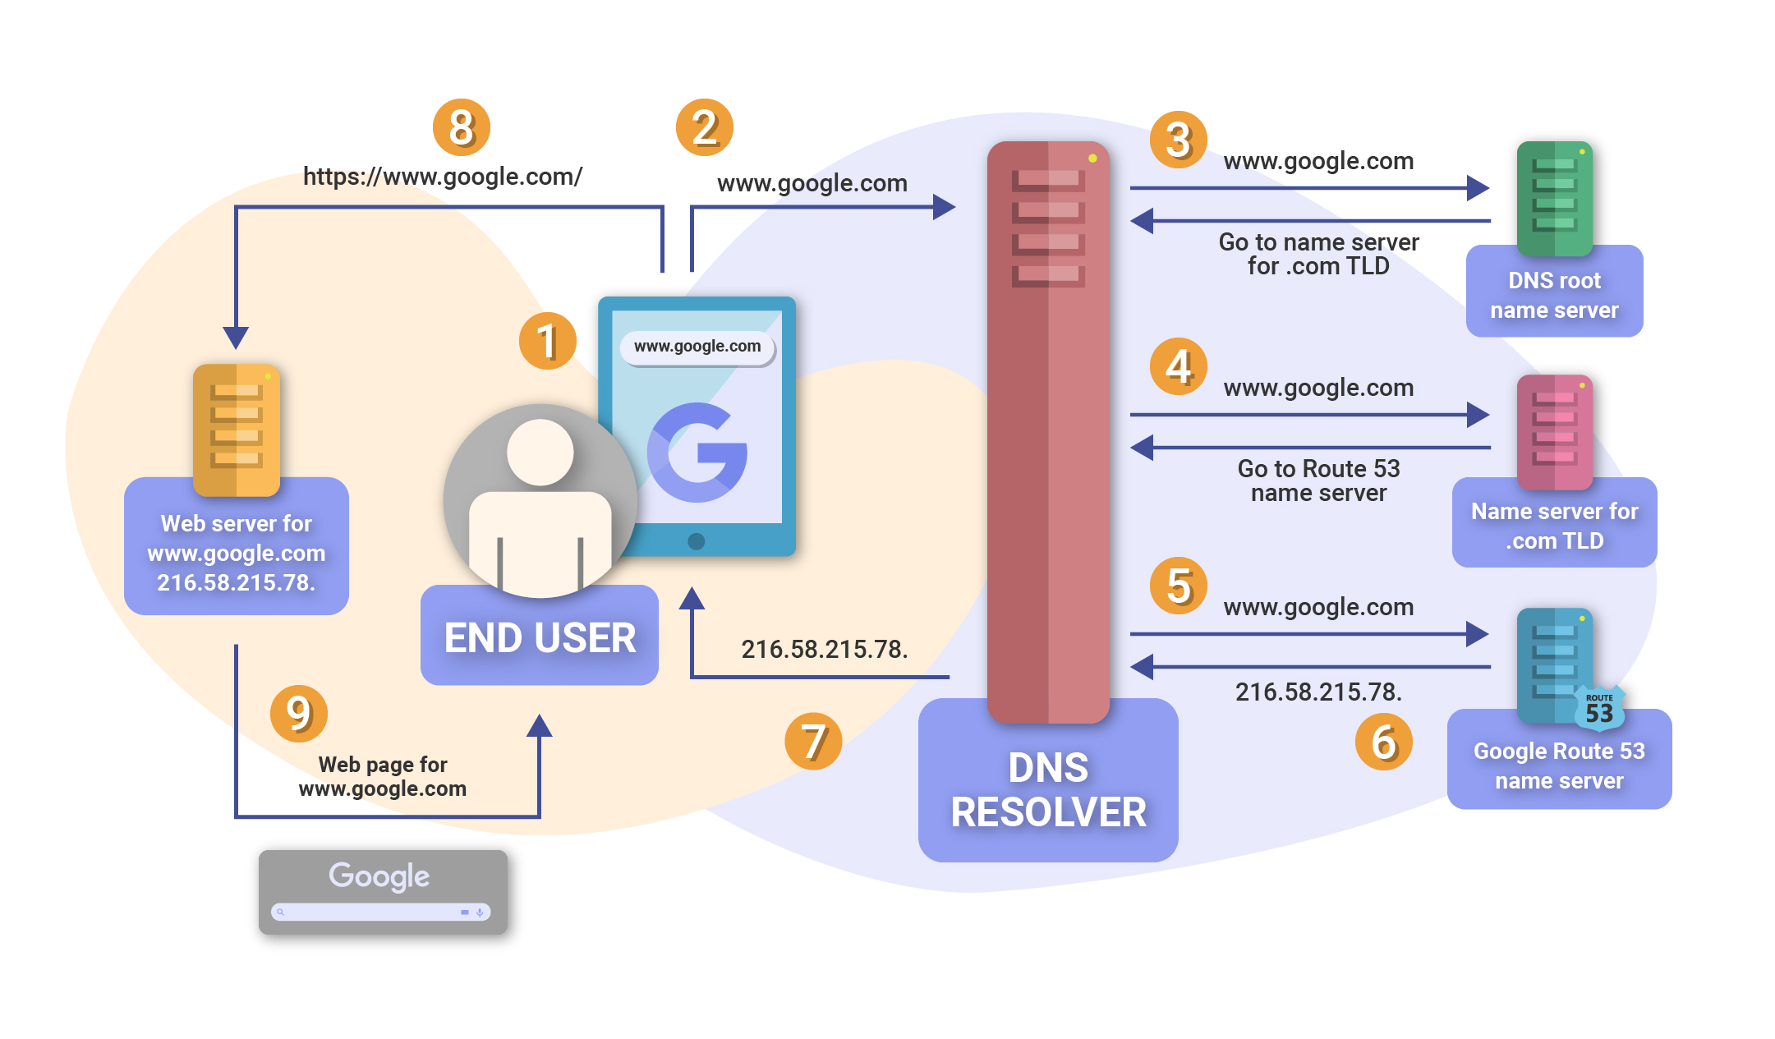
How internet Works ?

Slide 15
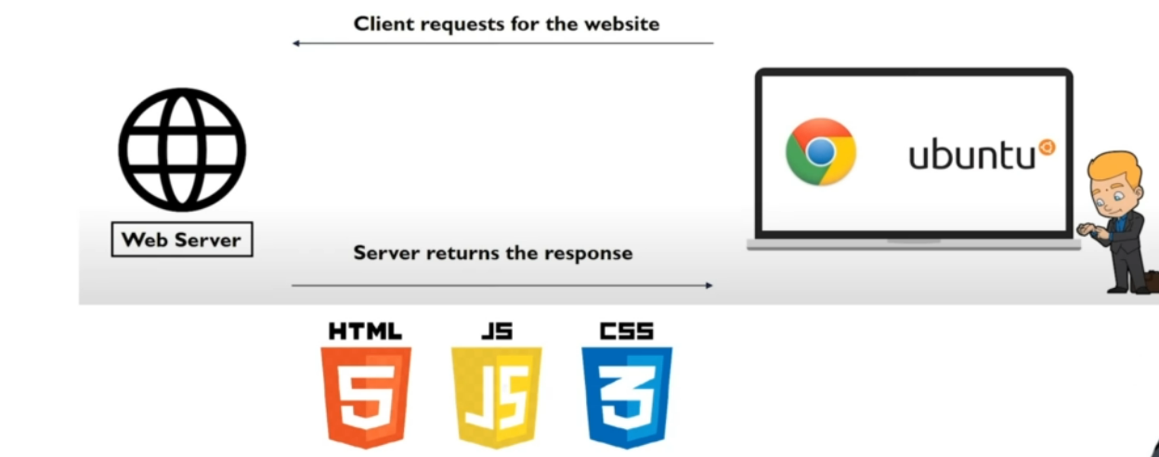
How a website works

Slide 16
3. Application Layer Protocols
The protocols in this layer deliver all of the Internet services we're familiar with:
HTTP (HyperText Transfer Protocol, TCP port 80): transmits web pages across the Internet
FTP (File Transfer Protocol, TCP ports 20 & 21): used for moving files from one machine to another
SMTP (Simple Mail Transfer Protocol, TCP port 25): for sending e-mail messages
POP3 (Post Office Protocol, version 3, TCP port 110): for retrieving e-mail messages from a e-mail server
NNTP (Network News Transfer Protocol, TCP port 119): network newsgroups
Telnet (TCP port 23): allows users to log on to remote computers just as if they were sitting in front of the remote computer
DNS (Domain Name Service, UDP port 53): translates the machine name part of the URL into IP addresses.

Slide 17
3.1 HTTP and HTTPs?
Hypertext Transfer Protocol (HTTP) is a communications protocol. Its use for retrieving inter-linked text documents (hypertext) led to the establishment of the World Wide Web.
HTTP is a request/response standard between a client and a server.
A client is the end user, the server is the web site. The client making a HTTP request—using a web browser, or other end-user tool—is referred to as the user agent. The responding server— which stores or creates resources such as HTML files and images—is called the origin server

Slide 18
3.1.1 HTTP
an HTTP client initiates a request.
It establishes a Transmission Control Protocol (TCP) connection to a particular port on a host (port 80 by default).
An HTTP server listening on that port waits for the client to send a request message. Upon receiving the request, the server sends back a status line, such as "HTTP/1.1 200 OK", and a message of its own, the body of which is perhaps the requested file, an error message, or some other information.
Resources to be accessed by HTTP are identified using Uniform Resource Locators (URLs)) using the http: or https URI schemes.

Slide 19
3.1.2 HTTPS
Hyper Text Transfer Protocol Secure (HTTPS) is the secure version of HTTP, the protocol over which data is sent between your browser and the website that you are connected to.
The 'S' at the end of HTTPS stands for 'Secure'. It means all communications between your browser and the website are encrypted.
HTTPS is often used to protect highly confidential online transactions like online banking and online shopping order forms.
Web browsers such as Internet Explorer, Firefox and Chrome also display a padlock icon in the address bar to visually indicate that HTTPS connection is in effect.
This ensures reasonable protection from eavesdroppers but is weak with man-in-the-middle attacks.

Slide 20
(Continued…)
SSL certificates contain the computer owner's "public key."
The owner shares the public key with anyone who needs it. Other users need the public key to encrypt messages to the owner.
The owner sends those users the SSL certificate, which contains the public key.
The owner does not share the private key with anyone.
The security during the transfer is called the Secure Sockets Layer (SSL) and Transport Layer Security (TLS).
The procedure for exchanging public keys using SSL Certificate to enable HTTPS, SSL and TLS is called Public Key Infrastructure (PKI).

Slide 21
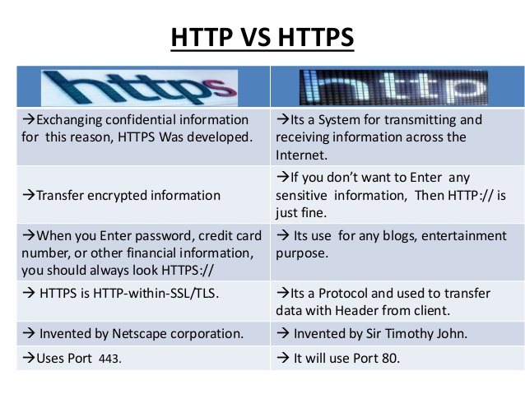
(Continued…)

Slide 22
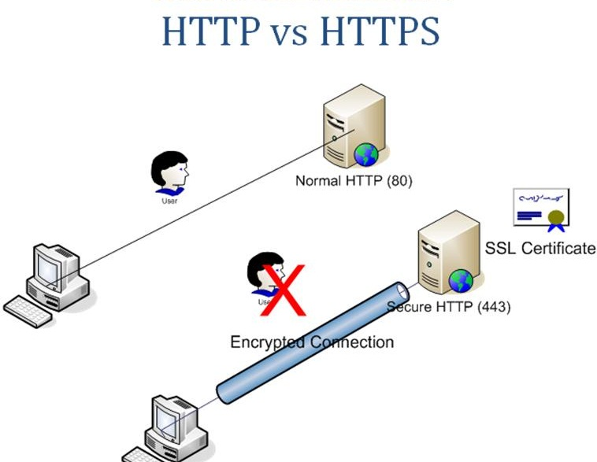
(Continued…)

Slide 23
4. What is DNS ?
The domain name is basically the address of your website, a nickname for its IP address.
Domains can be assigned to IPs by a Domain Name Registry headed by the Internet Assigned Numbers Authority (IANA).
When we type in a URL, an application-layer service called the Domain Name Service (DNS) translates the human-friendly URL into the computer-friendly IP address for us.
DNS performs this translation by consulting the databases maintained by the Domain Name Registrars. DNS is responsible for translating "www.apple.com" into "17.112.152.32" whenever we type that into a browser address bar. DNS is the "phone book" of the Internet: look up a name, and find its number.
TCP/IP, or the Transmission Control Protocol/Internet Protocol, is a suite of communication protocols used to interconnect network devices on the internet.TCP/IP can also be used as a communications protocol in a private network (an intranet or an extranet).

Slide 24
5. Uniform Resource Locators (URLs)
Humans being humans, prefer not to have to remember IP addresses like "17.112.152.32".
Instead, we'd rather use a little piece of text like "www.CBE.com", which is called a Uniform Resource Locator, or URL (pronounced "You-Are-Elle", or sometimes "Earl").
In fact, both 17.112.152.32 and www.CBE.com refer to the same Internet host: CBE Computer's webserver.
URL's are used for more than just websites; they're also used for e-mail addresses, FTP servers, network newsgroups, or any other service running on a computer connected to the Internet.

Slide 25
(Continued…)
A URL is made up of many parts. For example, consider the following:
http://www.FTI.edu/registrat/grader/index.html
http is the application-layer protocol. In this case HTTP, the protocol used by the
World Wide Web.
www.FTI.edu is the Fully Qualified Domain Name (FQDN). In turn, the FQDN is made up of pieces as well (from right to left, or most general to most specific).
.com is the Top Level Domain (TLD), in this case meaning “educational institute"
FTI is the specific company/institute name, chosen by FTI Computer.
www is the name of the webserver hosting FTI Computer's website.
/Reg/grade/index.html is the path to the requested HTML page on the webserver. This path and file is used by the webserver to figure out which file to return to a browser. Other application-layer protocols might not need a path or file name.

Slide 26
Protocols determine network language
Usually http or https for web browsers
Other Common Protocols:
https:// (secure)
ftp:// (file transfer)
mailto:// (e-mail address)
file:// (local files)

Slide 27
Subdomain
Top-Level Domain
Subdomains
www (web server, sometimes optional)
ftp (file server)
en (“English” on Wikipedia)
www.cs (“Computer Science”, “web” at Pitt)
Top-Level Domains (TLD)
.com, .org, .net, .gov, .mil
.us, .ca, .uk, .jp
newer ones: .biz, .info, …

Slide 28
(Continued…)
Top Level Domains
There are only a few top level domains, and these are controlled by one of the Internet self-regulating authorities(ICANN [www.icann.org]).
The most common TLDs are as follows:
.com: companies or commercial ventures
.net: ISPs or other companies that work with the Internet
.org: non-profit organizations and institutions
.mil: military
.edu: education institutions
.gov: government
Recently, ICANN specified some new TLDs that haven't really caught on much yet:
.info, .biz, .pro, .museum, etc.
TLDs are also assigned to countries:
.et: Ethiopia
.us: United States
.uk: United Kingdom

Slide 29
6. What is Web Browser?
A web browser (also referred to as an Internet browser or simply a browser) is application software for accessing the World Wide Web or a local website.
A web browser takes you anywhere on the internet, letting you see text, images and video from anywhere in the world.
Web browsers are used primarily for displaying and accessing websites on the internet, as well as other content created using languages such as Hypertext Markup Language (HTML) and Extensible Markup Language (XML).
Browsers translate web pages and websites delivered using Hypertext Transfer Protocol (HTTP) into human-readable content. They also have the ability to display other protocols and prefixes, such as secure HTTP (HTTPS), File Transfer Protocol (FTP), email handling (mailto:), and files (file:).
In addition, most browsers also support external plug-ins required to display active content, such as in-page video, audio and game content.

Slide 30
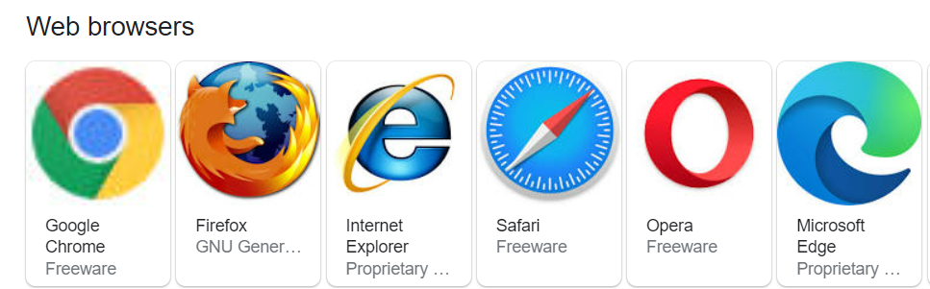
(Continued…)
Currently you must be using any sort of Web browser while you are navigating through a website On the Web, when you navigate through pages of information, this is commonly known as web browsing or web surfing.

Slide 31
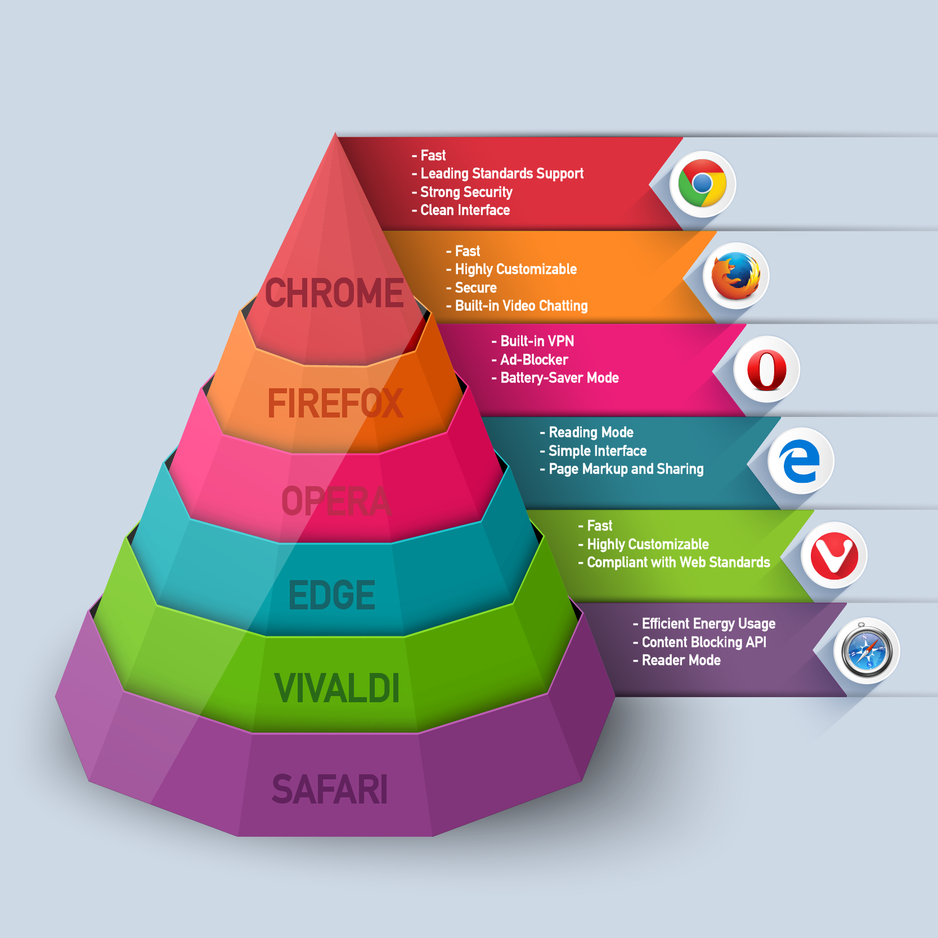
Web Browser Comparison

Slide 32
7. Web Site Development Basics
Who’s a web developer?
Those websites which you scroll to are created by none other than web developers
In Web Development we have 3 paths:
Frontend developer
Backend developer
Full-stack developer

Slide 33
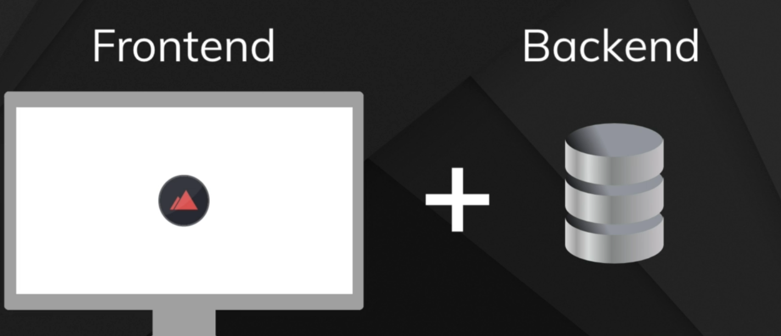
7.1 Frontend developer
Front-End is the UI (User Interface), it deals with the website’s overall appearance, on how interactive and dynamic it is.
For mastering it, get clear with all the elements of HTML, CSS, and JavaScript

Slide 34
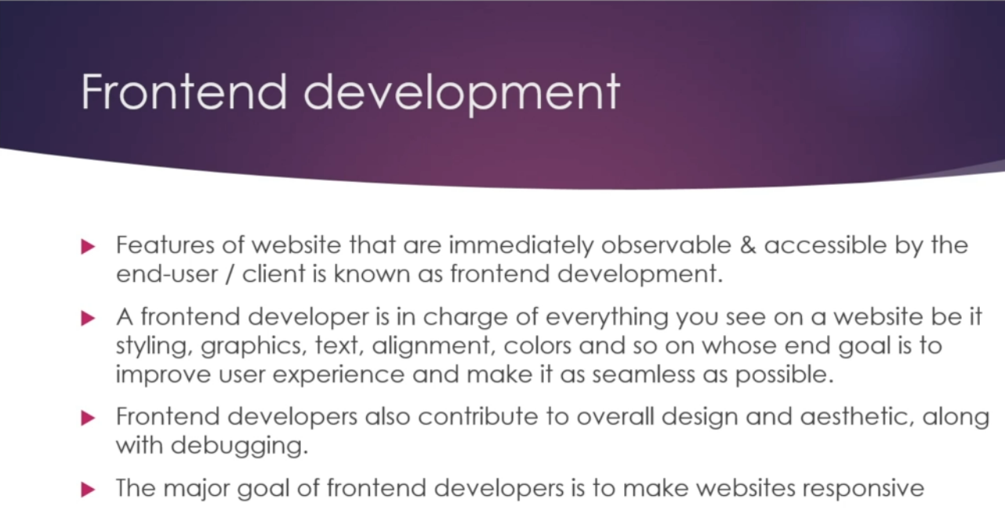

Slide 35
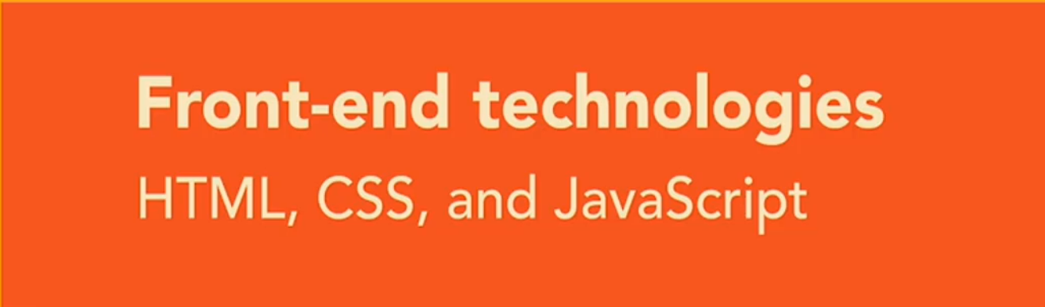
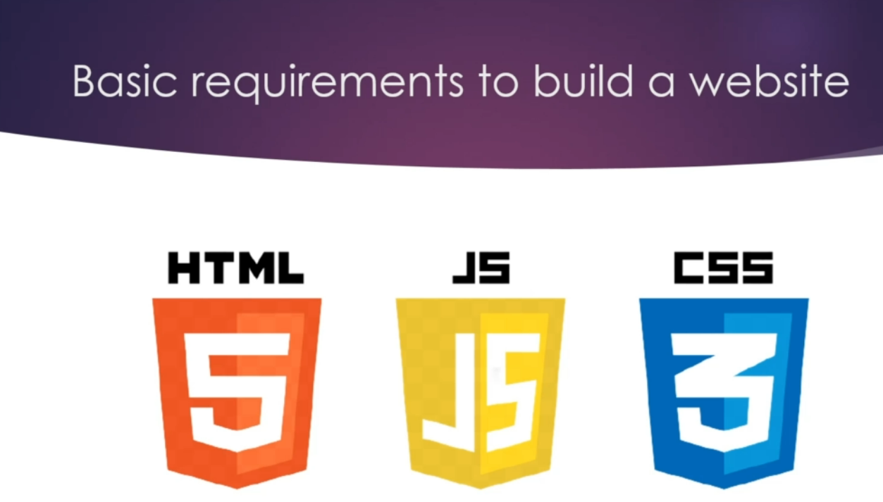

Slide 36
Hypertext Markup Language(HTML)
HTML, in full hypertext markup language, a formatting system for displaying material retrieved over the Internet.
Each retrieval unit is known as a Web page (from World Wide Web), and such pages frequently contain hypertext links that allow related pages to be retrieved.

Slide 37

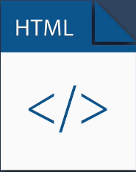

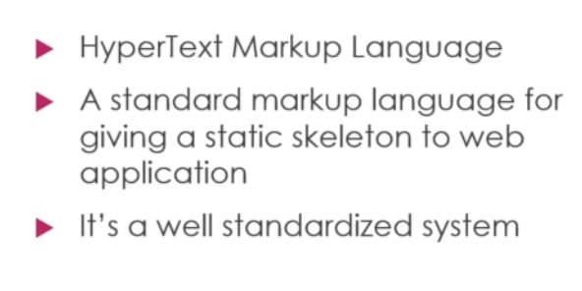
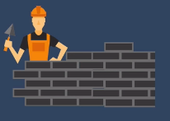

Slide 38
Cascading Style sheets (CSS)
CSS helps us to control the text color, font style, the spacing between paragraphs, sizing of columns, layout designs, and many more.
It is independent of HTML, and we can use it with any XML-based markup language. It is recommended to use CSS because the HTML attributes are being deprecated.

Slide 39

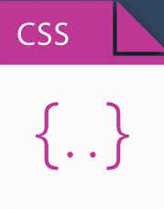

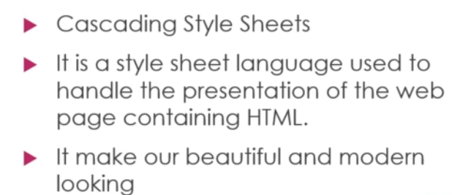


Slide 40
Java Script (JS)
What is JavaScript and why it is used?
JavaScript is a text-based programming language used both on the client-side and server-side that allows you to make web pages interactive.
Where HTML and CSS are languages that give structure and style to web pages, JavaScript gives web pages interactive elements that engage a user

Slide 41

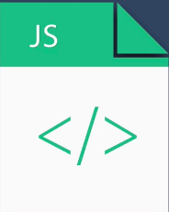


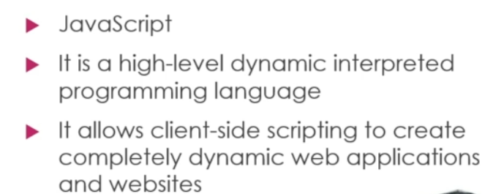

Slide 42

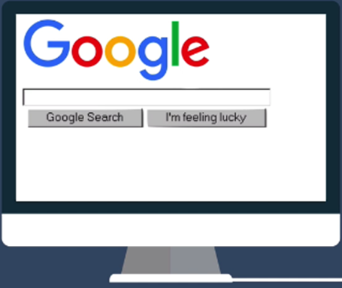
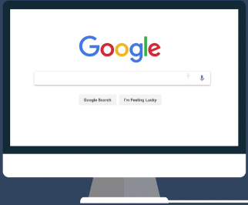
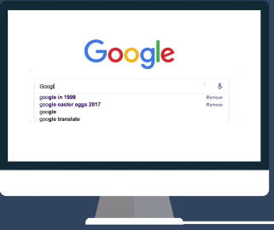

Frontend With Example

Slide 43
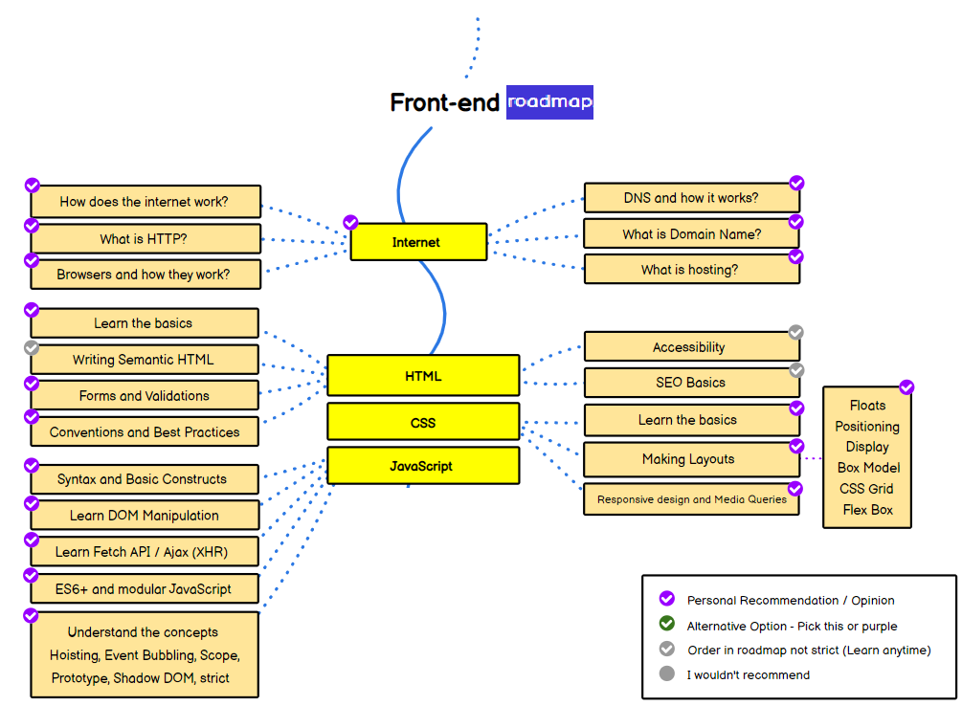
Frontend Roadmap

Slide 44
7.2 Backend developer
Back-end developers are the experts who build and maintain the mechanisms that process data and perform actions on websites.
Unlike front-end developers, who control everything you can see on a website, back-end developers are involved in data storage, security, and other server-side functions that you cannot see

Slide 45
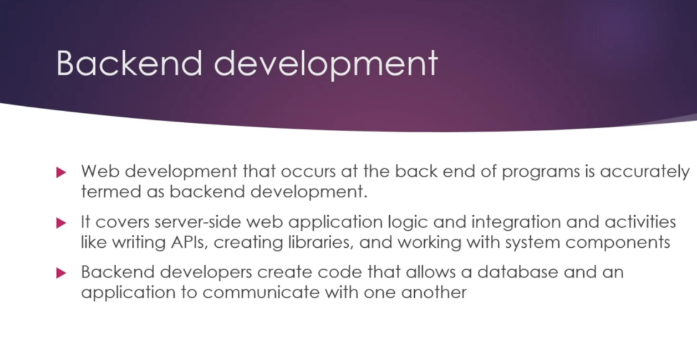

Slide 46
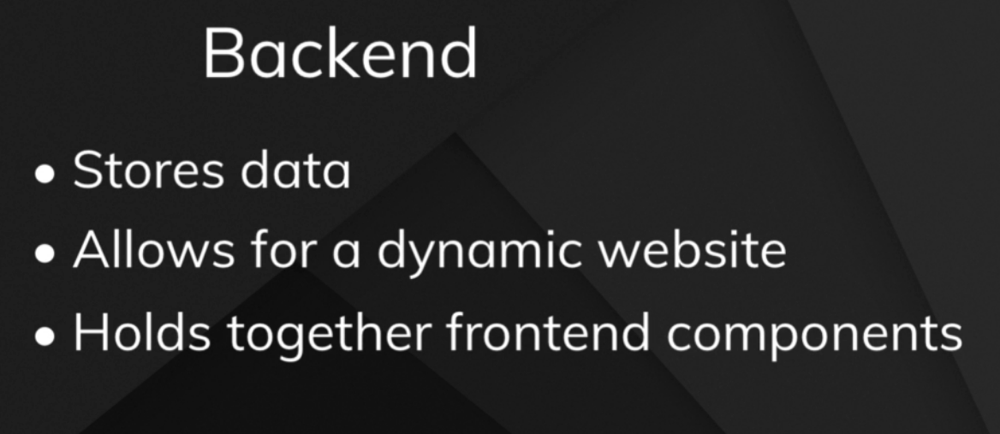

Slide 47
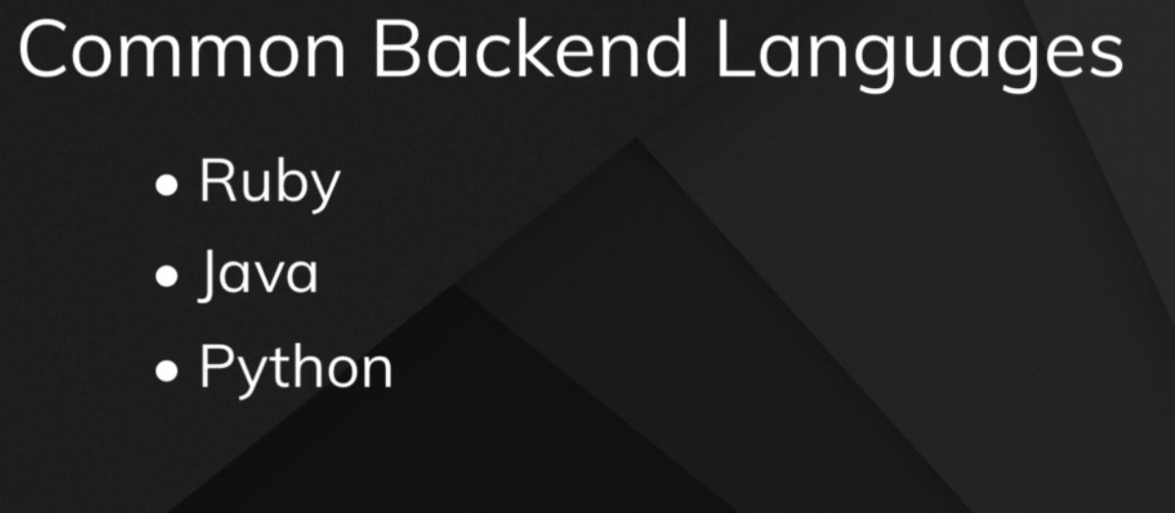
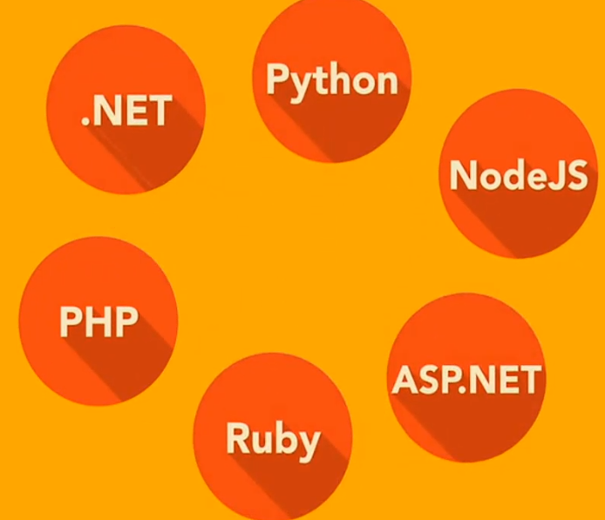

Slide 48
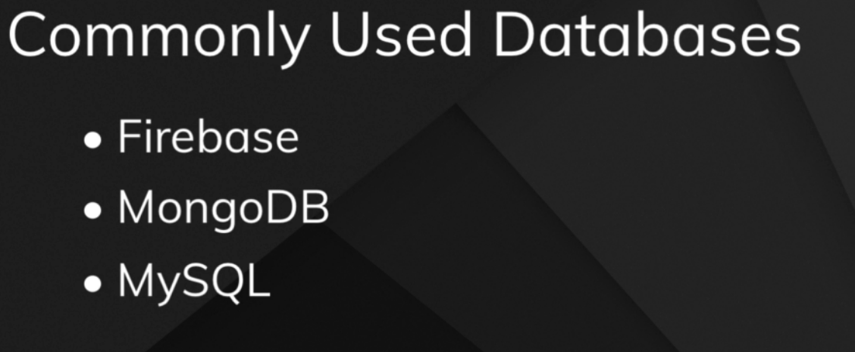

Slide 49
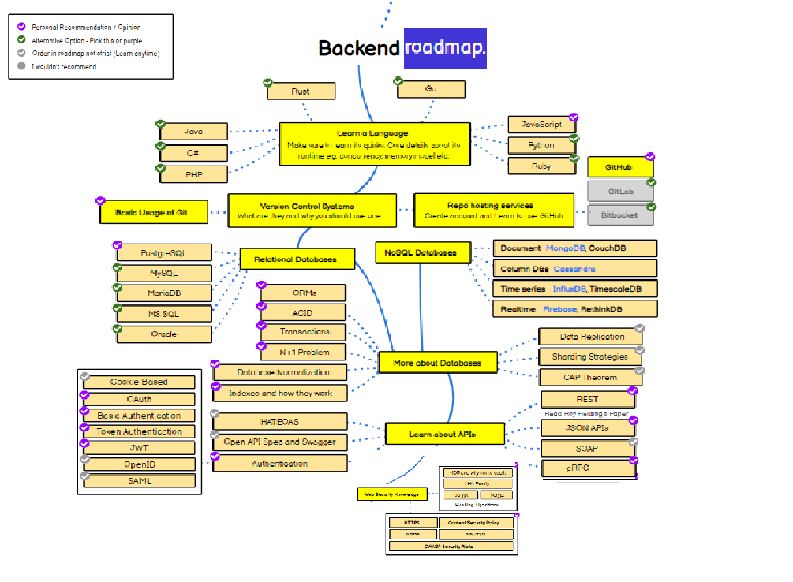
Back end road map

Slide 50
7.3 Full-stack developer
A full-stack web developer looks after both the front-end and the back-end parts.

Slide 51
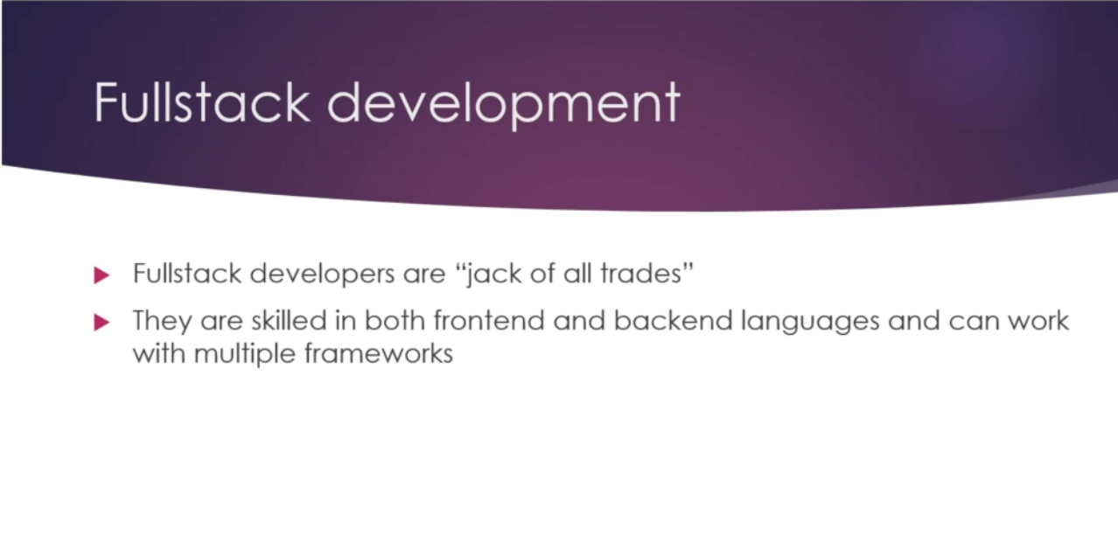

Slide 52
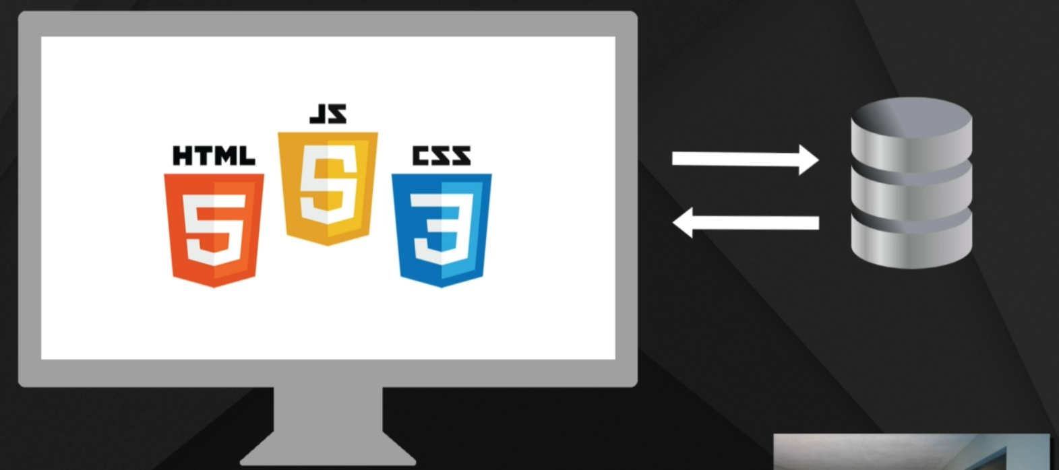

Slide 53

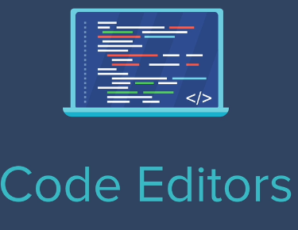

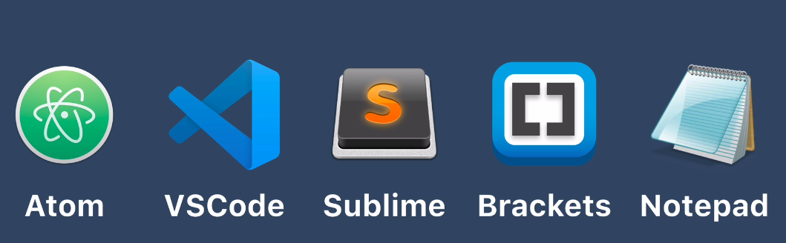
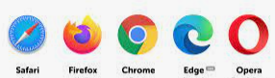
7.4

Slide 54
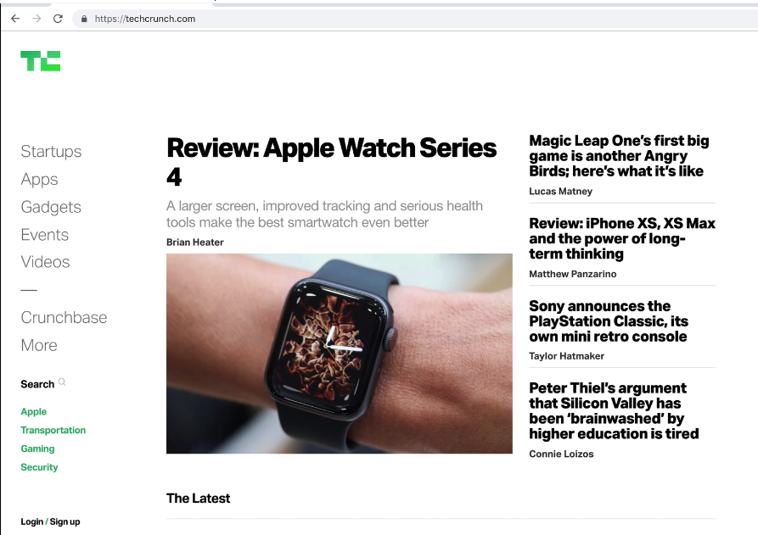
Sample web page

Slide 55
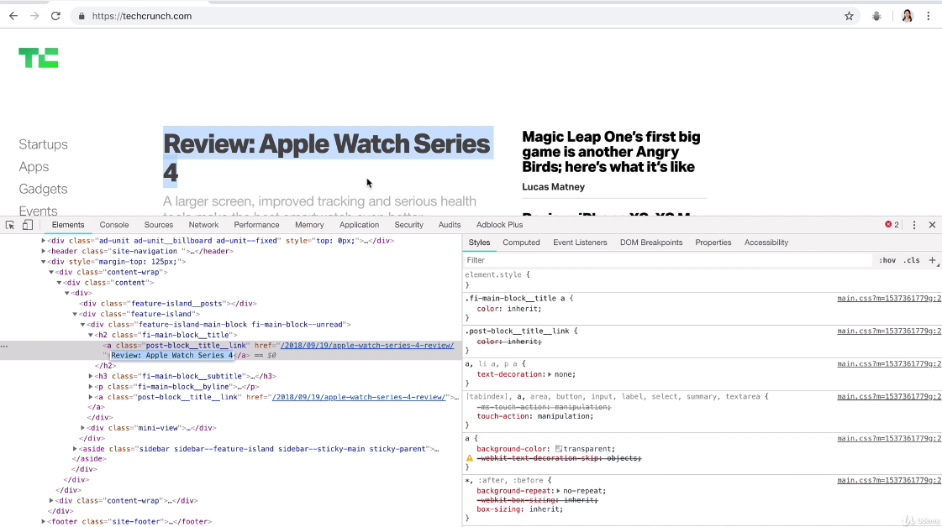
Inspecting source code of a web page

Slide 56
Web Contents
Web content is the textual, visual or aural content that is encountered as part of the user
experience on websites.
It may include, among other things: text, images, sounds, videos andanimations.
HTML web content
Even though we may embed various protocols within web pages, the "web page" composed of "html" (or some variation) content is still the dominant way whereby we share content.
And while there are many web pages with localized proprietary structure (most usually, business websites), many millions of websites abound that are structured according to a common core idea.

Slide 57
Types of Website Content
A website, or individual web page, can be static or dynamic.
Static Web Site
Dynamic Web Site

Slide 58
Static Web Site
A static website or static web page contains information that doesn't change automatically. It remains the same, or static, for every viewer of the site.
A static web page (sometimes called a flat page) is a web page that is delivered to the user exactly as stored.
A static web page displays the same information for all users, from all contexts, subject to modern capabilities of a web server to negotiate content-type or language of the document where such versions are available and the server is configured to do so.
Static web pages are often HTML documents stored as files in the file system and made available by the web server over HTTP.
Static Web pages are very simple in layout and informative in context.

Slide 59
Advantages and Disadvantages of Static Web Site
Advantages
No programming skills are required to create a static page.
Inherently publicly cacheable (i.e. a cached copy can be shown to anyone).
No particular hosting requirements are necessary.
Can be viewed directly by a web browser without needing a web server or application server, for example directly from a CDROM or USBDrive
Disadvantages
Any personalization or interactivity has to run client-side (ie. In the browser), which is restricting.
Maintaining large numbers of static pages as files can be impractical without automated tools

Slide 60
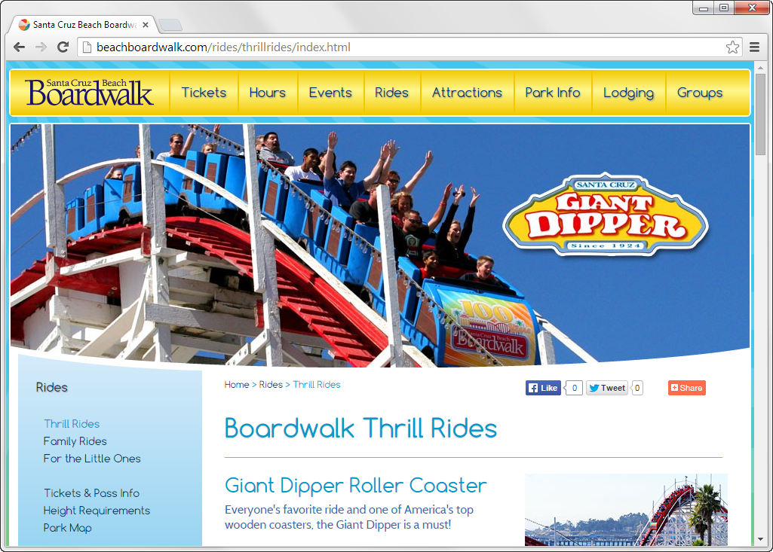

Slide 62
Dynamic Web Sites
A dynamic website or dynamic web page contains information that changes, depending on the viewer, the time of the day, the time zone, the viewer's native language, and other factors.
A dynamic web page is a kind of web page that has been prepared with fresh information (content and/or layout), for each individual viewing.
It is not static because it changes with the time (ex. news content), the user (ex. preferences in a login session), the user interaction (ex. web page game), and the context (parametric customization), or any combination of the foregoing.
A dynamic website can contain client-side scripting or server-side scripting to generate the changing content or a combination of both scripting types. These sites also include HTML programming for the basic structure. The client-side or server-side scripting takes care of the guts of the site.

Slide 63
Application areas of Dynamic Website
Dynamic web page is required when the following necessities arise:
Need to change main pages more frequently to encourage clients to return to the site.
Long list of products/services offered that are also subject to upgradation
Introducing sales promotion schemes from time to time
Need for a more sophisticated ordering system with a wide variety of functions
Tracking and offering personalized services to clients.
Facility to connect Web site to the existing back-end system.

Slide 64
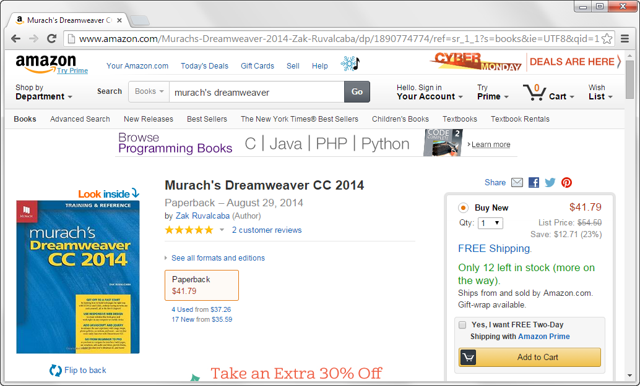

Slide 66
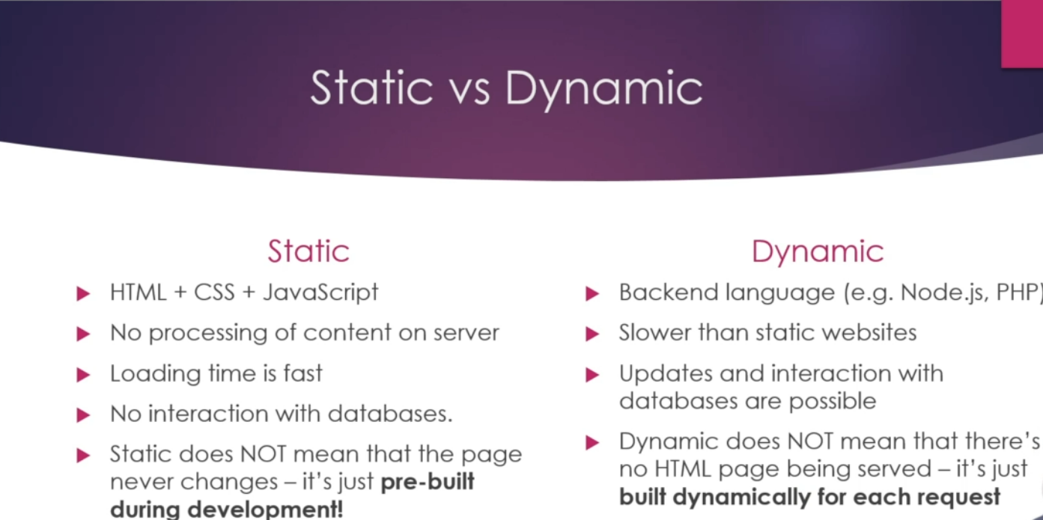

Slide 67
8. Web and internet Terminologies
Website:
A website is a set of web pages consisting of text, audio and video. Web servers host websites.
Web Page:
Web pages are resources of information. They are generally created in the HTML format and provide the web users with navigational abilities through hyperlinks to other web pages on the web.
Home Page:
The term home page is used to refer to the page that is the default page of any website. It is the main page of a complex website.
Web Browser:
A web browser is a software application that facilitates user interaction with the text, audio, video and other information that is located on the web.

Slide 68
Bounce Rate
A website’s bounce rate is the percentage of people who leave the site from the same page they entered the site, without clicking through to any other pages.
Client-Side
Client-side refers to scripts that are run in a viewer’s browser, instead of on a web server (as in server-side scripts). Client-side scripts are generally faster to interact with, though they can take longer to load initially.
Server-Side
Server-side refers to scripts run on a web server, as opposed to in a user’s browser. Server-side scripts often take a bit longer to run than a client-side script, as each page must reload when an action is taken.

Slide 69
Content Management System
Also known as a CMS, the Content Management System is a backend tool for managing a site’s content that separates said content from the design and functionality of the site.
Using a CMS generally makes it easier to change the design or function of a site independent of the site’s content. people who aren’t programmers, saving on the cost of hiring a programmer because you can add/edit/delete content yourself.

Slide 70
Web and internet Terminologies
Hyperlink
A hyperlink is a link from one web page to another, either on the same site or another one. Generally these are text or images, and are highlighted in some way (text is often underlined or put in a different color or font weight). The inclusion of hyperlinks are the “hyper” part of “hypertext.”
Meta Data
Meta data is the data contained in the header that offers information about the web page that a visitor is currently on. The information contained in the meta data isn’t viewable on the web page (except in the source code). Meta data is contained within meta tags.

Slide 71
Navigation
Navigation refers to the system that allows visitors to a website to move around that site. Navigation is most often thought of in terms of menus, but links within pages, related links, and any other links that allow a visitor to move from one page to another are included in navigation.
Open Source
Open source refers to the source code of a computer program being made available to the general public. Open source software includes both web-based and desktop applications. Open source programs are generally free or very low cost and are developed by teams of people, sometimes comprised mostly of volunteers.
Plug-In
A plug-in is a bit of third party code that extends the capabilities of a website. It’s most often used in conjunction with a CMS or blogging platform. Plug-ins are a way to extend the funtionality of a website without having to redo the core coding of the site. Plugins can also refer to bits of third-party software installed within a computer program to increase its functionality.

Slide 72
Script
Generally refers to a portion of code on an HTML page that makes the page more dynamic and interactive. Scripts can be written in a variety of languages, including JavaScript.
Web Server
A web server is a computer that has software installed and networking capabilities that allow it to host web sites and pages and make them available to internet users located elsewhere. There are a few different setups that can be used for a web server, including the LAMP setup mentioned earlier.

Slide 73
Web Standards
Standards are specifications recommended by the World Wide Web Consortium for standardizing website design. The main purpose of web standards is to make it easier for both designers and those who create web browsers to make sites that will appear consistent across platforms.
This can be checked through various validation services, most commonly the one from W3C.
ASP
A coding language that is compatible with Windows servers. Normally used for increased functionality on a website or to work with a database. It works in conjunction with html and html variants.
BLOG
An online journal or diary and a very popular current method of sharing your thoughts with the world. It is also very popular as a marketing tool. This article is found within Thinking IT’s blog.
ISP
Internet Service Provider. The company that provides you with internet access (connection) and related services is your ISP.

Slide 74
SEARCH ENGINE
A programme that collects, stores, arranges and normally ranks the various resources available on the internet. It is most commonly on a website and used to find other websites – much like the yellow pages is used in the brick and mortar world.
SITEMAP: This is an index to all the content on a website. It is normally accessible from at least the front page of the site and is used for two purposes: to help people find what they are looking for on the site and to help search engines find all your links.

Slide 75
Cache: Web browsers maintain a cache of recently visited web pages. Some of them use an external proxy web cache, which is a server program through which web requests pass. This enables the browsers to cache frequently visited pages. Even search engines make available already indexed web pages through their caches.
Web Cookie: Also known as an HTTP cookie, it is piece of text that is exchanged between the web client and the web server. It is sent by the web server to the web client and returned unchanged by the client each time it accesses the server.
Session: It is an exchange of information between a computer and its user. It is established for a certain period of time after which it ends.
Hyperlink: A reference in a document to another section of the document or to another document is termed as a hyperlink. Hyperlinks are used to redirect the user from one section of a page content to another.

Slide 76
Spamming: The act of sending unsolicited bulk messages over an email system is known as spamming. It is an undesirable use of the electronic messaging systems.
Phishing: It is a fraudulent activity of acquiring the sensitive information by the use of a fake identity during electronic communication. It is implemented by means of emails and instant messages wherein a user is lured to enter his/her details, which are actually captured by a fraudulent website.
Hacking: Hacking is the activity of programmatically gaining access to a computer application that is otherwise inaccessible. The act of gaining an unauthorized access to a computer is known as hacking. Hacking of passwords that leads to breach of email privacy is a threat to communication over the Internet. Internet crimes refer to all the criminal activities that are carried over the Internet.
Email Virus: It is a computer code that is transmitted through an email in the form of an attachment. The email attachment causes the destruction of some of the files on the receiver computer’s hard disk and is programmatically emailed to the contacts in the address book of the receiver.

